Slide 1

Customer Shopping Behavior Analysis
Uncovering insights from 3,900 purchases to guide strategic business decisions.

Slide 2


Project Overview & Goals
Analyze Purchases
Uncover Insights
3,900 transactions across various product categories.
Identify spending patterns, segments, and product preferences.
Guide Strategy
Inform business decisions on pricing, loyalty, and marketing.

Slide 3

Dataset Summary: Key Features
Demographics
Purchase Details
Shopping Behavior
Age, Gender, Location, Subscription Status.
Item, Category, Amount, Season, Size, Color.
Discount, Promo Code, Previous Purchases, Frequency, Rating, Shipping.
Total Rows: 3,900. Missing Data: 37 values in Review Rating.

Slide 4

Data Preparation & Cleaning (Python)
Loading & Exploration
Imported dataset, checked structure and summary statistics.
Handling Missing Data
Imputed missing Review Rating using median by category.
Standardization
Renamed columns to snake case for readability.
Feature Engineering
Created age_group and purchase_frequency_days.
Database Integration
Loaded cleaned data into MySQL for structured analysis.

Slide 5
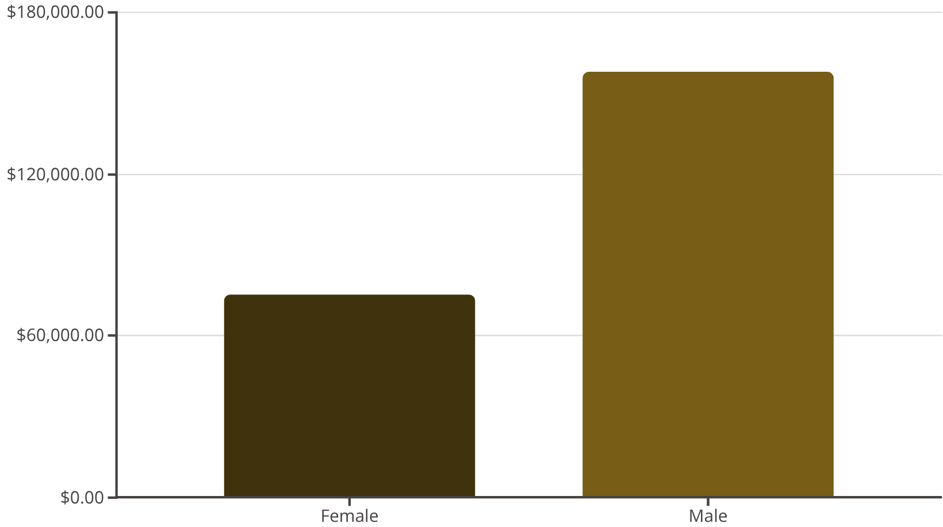
Key Business Insights: Revenue & Spend
Revenue by Gender
Subscribers vs. Non-Subscribers
Status
Avg. Spend
Total Revenue
Yes (1053 customers)
$59.49
$62,645
No (2847 customers)
$59.87
$170,436
Male customers generate significantly higher revenue.
Non-subscribers have slightly higher average spend.

Slide 6

Product Performance & Ratings
Top 5 Products by Rating
1
Gloves (3.86)
Sandals (3.84)
Boots (3.82)
Discount-Dependent Products
2
Hat (50.00% discounted)
Sneakers (49.66% discounted)
Coat (49.07% discounted)
Top-rated items should be highlighted in campaigns. Review discount policy for high-discount items.

Slide 7

Customer Segmentation
Returning — 701
Loyal — 3,116
New — 83
3116
701
83
Loyal Customers
Returning Buyers
New Customers
Largest segment based on purchase history.
Opportunity for loyalty program conversion.
Focus on onboarding and retention strategies.

Slide 8
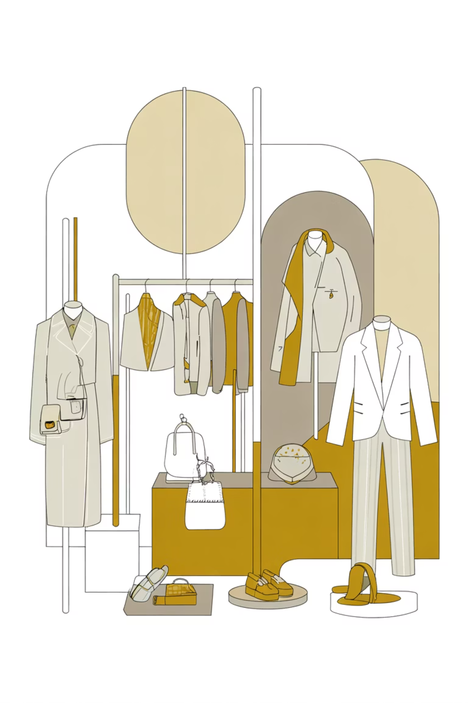
Top Products Per Category
Accessories
Jewelry (171 orders)
Sunglasses (161 orders)
Belt (161 orders)
Clothing
Blouse (171 orders)
Pants (171 orders)
Shirt (169 orders)
Footwear
Sandals (160 orders)
Shoes (150 orders)
Sneakers (145 orders)
Outerwear
Jacket (163 orders)
Coat (161 orders)

Slide 9

Age & Shipping Behavior
Revenue by Age Group
Shipping Type Comparison
Senior: $93,410
Average Purchase Amount:
Middle-aged: $86,766
Express: $60.48
Adult: $52,905
Standard: $58.46
Targeted marketing should focus on the high-revenue Senior and Middle-aged groups.
Express shipping users spend slightly more on average.

Slide 10

Strategic Business Recommendations
Boost Subscriptions
Promote exclusive benefits to increase subscriber base.
Customer Loyalty
Reward repeat buyers to move them into the "Loyal" segment.
Review Discount Policy
Balance sales boosts with margin control on high-discount items.
Targeted Marketing
Focus efforts on high-revenue age groups and express-shipping users.

